Slide 1
Mental Health Conditions (MHCs) – an underestimated problem!
MHC account for 37% of lost DALYs (1)
1 in 5 children or adolescents have mental disorder (WHO)
MHC are a fast-growing problem
1 in 9 people in conflicts develop mental disorder
Notes:
How much of an impact might mental Health conditions play in the overall medical field?
MHCs account for 37% of lost Disability Adjusted Life Years for non-communitable diseases. Measure to estimate the impact of a disease has on the collective behaviour
Acc. To WHO: 1 in 5 children and adolescents have mental disorder https://www.who.int/news-room/facts-in-pictures/detail/mental-health
Expected to increase: 2010: estimated direct and indirect costs: 2.5 trillion US-D, 2030: 6 tr. USD
Acc to WHO: 1 in 9 people in conflict settings develop moderate or severe mental disorders: Time of increasing conflicts make the issue more pessing

Slide 2
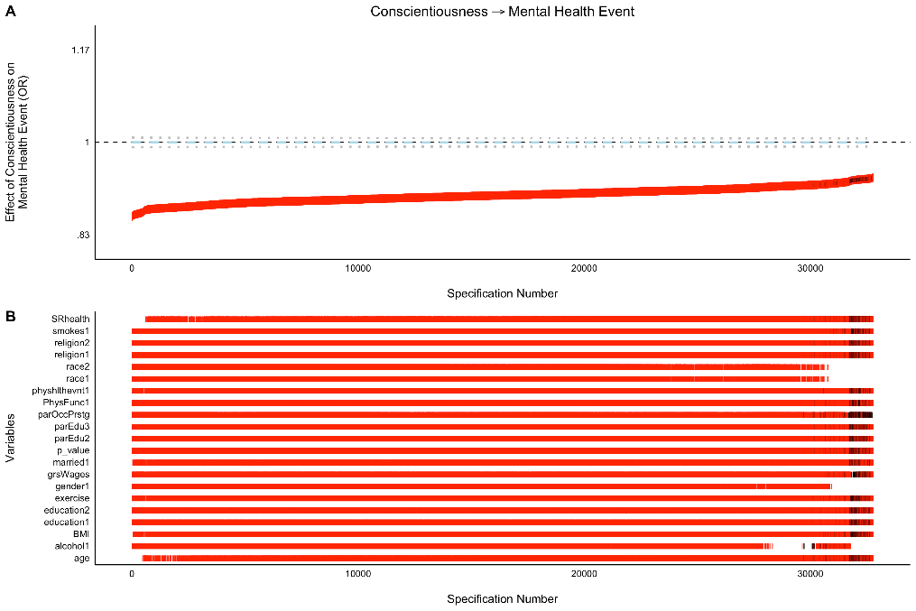
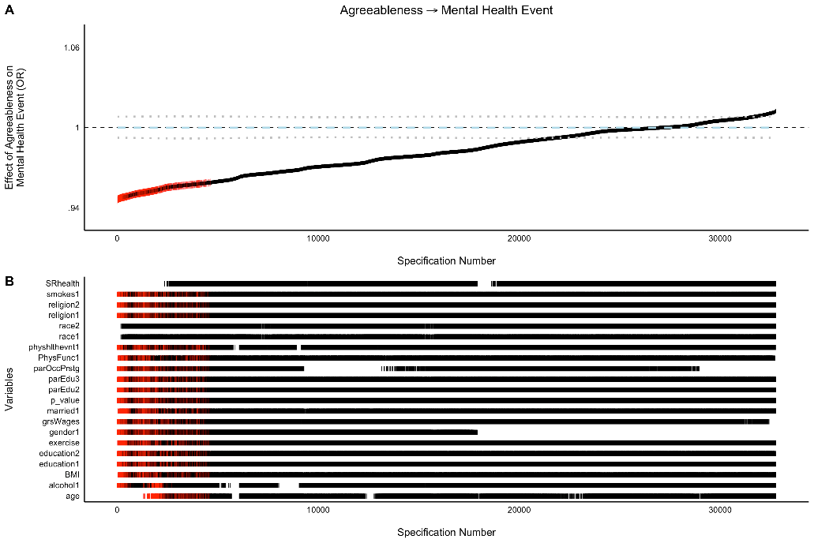
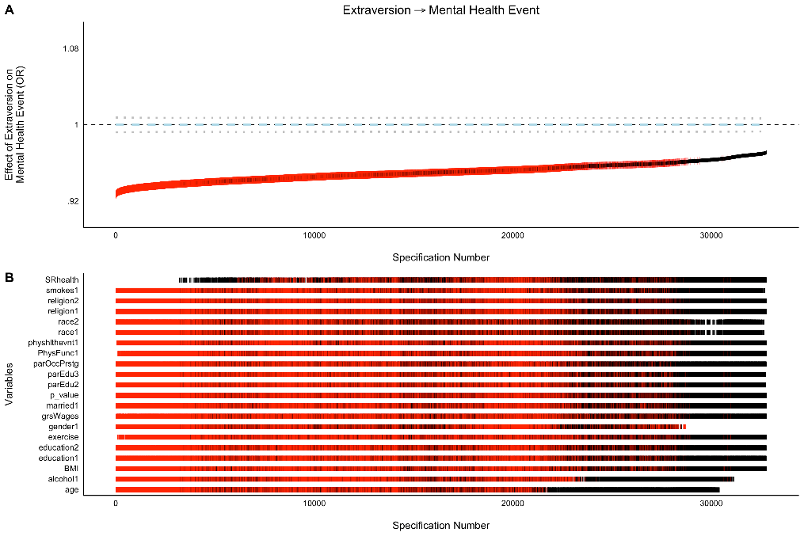
A Mega-Analysis of Personality Prediction (2)
Notes:
You may remember this study from last year (Emorie D. Beck) -> just got finally published this march after 1.5 years in review
Analyzed selection effects of the big 5 personality traits (and some other characteristics) on 14 broad outcomes while accounting foir background characteristics (across 10 large Panel studies)
Here, Lets have a look at some of the results for the Mental Health Event Outcome
Reminder: Odds Ratio Plotted for each individual model, sorted by effect size -> Red means effect is significant
-> This shows two things: First which personality traits have a stable effect on Mental Health Events when controlled for other variables
-> Secondly which of these variable are responsible for significant or non-significant results and therefore which one might be important to look at in more detail
For Mental Health, this includes things like: Gender, Race (Fixed Effects), but also Alcohol consumption, Level of Excercise, or Education

Slide 3
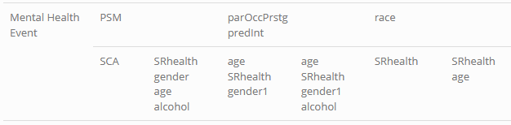
Considerations
Many activities are thought of as potentially beneficial or detremental to mental health
Notes:
A lot of studies out there, that claim that certain activities are beneficial or detremental to mental health, some more, some less believable, all reported very sensationally
Propensity Score Matching and Specification Curve analysis have shown that for different personality traits different covariates are critical

Slide 4
The Research Question
Do certain activities have a different effect on the mental health of people depending on their personality
Look at people with „extreme personality“ (highest/lowest 20% on each trait) -> create 5*2 individual models
Use regression model (POLS/FE) to model impact of each activity individually (for 2x5 personality samples)
Create a multiple regression model with the activities that showed the strongest impact on mental health
For each test: Control for
The other personality traits
Age, (gender), income, family status
Notes:
Sample: most extreme personalities
POLS: Pooled OLS
OLS: Ordinary least squares
-> Pooled Ordinary least squares
Use within regression (fixed effects, FE) -> This would be interesting if gender were to be used as a fixed effect

Slide 5
Relevant Variables and Datapoints
Data on Mental Health (dependent variable)
- mh_nbs: Mental Health norm based scoring (norm is 2004?)
- mcs: mental health composite scale
-> These scales are based on questions within the sf12 questionnaire
-> 12 questions regarding health associated quality of life, 4 from mental health (3)
Independent variables
(Physical) activity: (sports, internet usage, tv, musically active, volunteering, computer games, cultural events…)
Substance consumption: (Alcohol, Tobacco)
Maybe: Education & Competency: (Level of Education, Cognitive Competency, time spent reading)
Notes:
Unfortunately there is not much more on mental health
Not even visits to the psychotherapist?
For education: Not clear if this should be included, there is some evidence that this is important
Personality traits data, assumed to be fixed for the individuals (we have talked about that in the course, does this assumption hold?)

Slide 6
Open Questions
Does Demeaning/using a FE estimator make sense?
Mean could be an important factor in itself
Alternative approach: Use „normal“ population vs. „extreme personalities“ as dummy variables, then use single fixed effects model to estimate if dummy variable has significant (personality specific effect)
Notes:
Previous level of mental health could decide if an activity is helful or detremental

Slide 7
Citations
(1) Graeber, D. (2017). Does more education protect against mental health problems? (No. 113). DIW Roundup: Politik im Fokus. - https://www.diw.de/documents/publikationen/73/diw_01.c.565299.de/diw_roundup_113_en.pdf
(2) Beck, E. D., & Jackson, J. J. (2022). A mega-analysis of personality prediction: Robustness and boundary conditions. Journal of Personality and Social Psychology, 122(3), 523–553. https://doi.org/10.1037/pspp0000386
(3) Matthias Nübling, Hanfried H. Andersen, Axel Mühlbacher. (2006): Entwicklung eines Verfahrens zur Berechnung der körperlichen und psychischen Summenskalen auf Basis der SOEP-Version des SF12 (Algorithmus). DIW Berlin Data Documentation 16. Berlin: German Institute for Economic Research (DIW Berlin) - https://www.diw.de/documents/publikationen/73/diw_01.c.44987.de/diw_datadoc_2006-016.pdf

Slide 8
How does personality influence the effect of activities on mental health it‘s complicated!
Notes:
First, lets look at the items from the SOEP that are relevant for this analysis.
I have shown these distributions already in the last presentations, so move a bit faster, this is just a reminder!

Slide 9
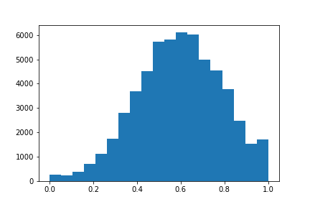
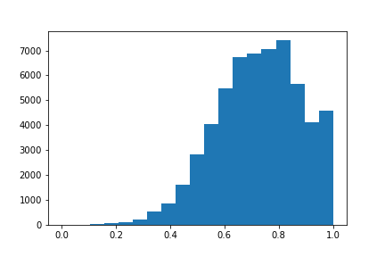
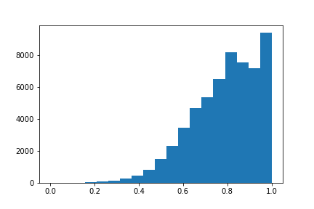
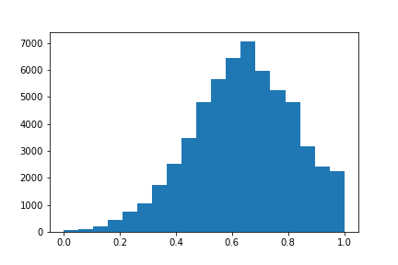
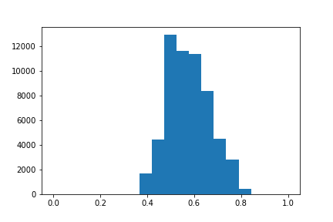
Personality trait distribution
Openness Agreeableness Conscientiousness Extraversion Neuroticism
Big 5 data available for 2005, 2009, 2013, 2017, 2019
Based on summative scales of 15/16 items (BFI-S)
Select „normal“, „extreme“ populations for each personality trait (.20, .80 perc)
Notes:
Why no fixed effects model: What would have been the fixed effect? Instead control for these variables!
THIS IS WITHIN SUBJECT TEST: REASON: LITTLE CHANGES BETWEEN BEHAVIOURS: SHOW THIS IN A PLOT

Slide 10
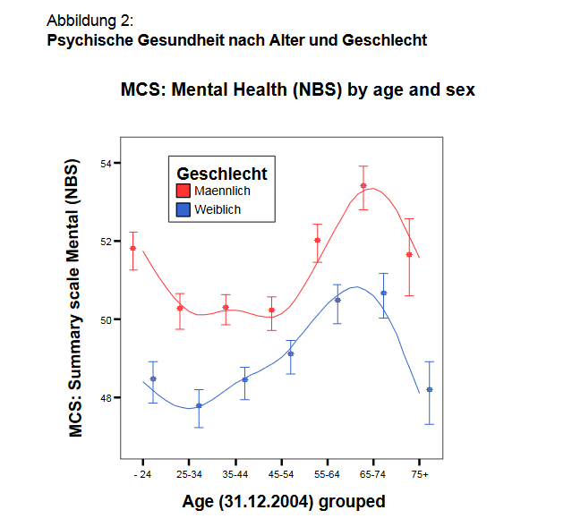
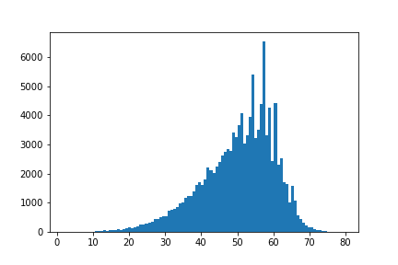
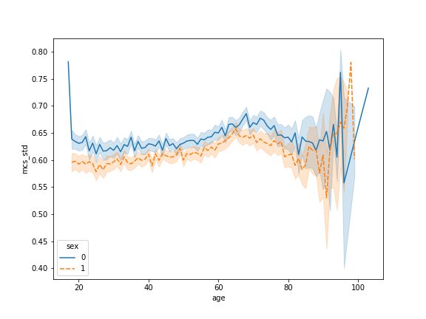
Mental health distribution
mcs: mental health composite scale
These scales are based on questions within the sf12 questionnaire
12 questions regarding health associated quality of life, 4 from mental health (3)
Available since 2002, every 2 years
Notes:
Reminder
Mental Health measured by mental composite score
I had presented this last time already
On the right: MCS distribution
Middle: data from all years included in my survey
Right: Data from the orginal paper that proposed MCS (Data just for 2004)

Slide 11
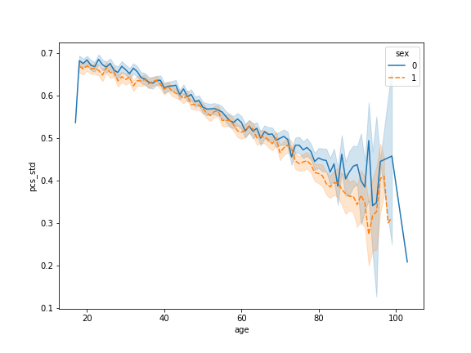
Control Variables: Age and PCS
Research has indicated relationships between Physical and Mental Health -> Added PCS as additional control variable
Notes:
But this is persistent for the data from all years
Since last time, I added the Physical health as a control variable
Similar effect for sex (male have slightly), but completely other age pattern for

Slide 12
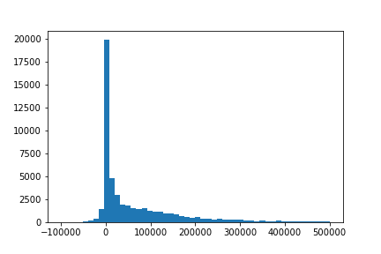
Control Variables: Wealth
Using netto data (gross data – debt): pl/w0111a
Wealth data available for 2002, 2007, 2012, 2017
Values below -100,000 (126), above 500,000 (1612) omitted
Notes:
Contol Variables

Slide 13
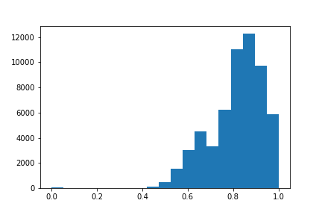
Personality trait distribution
Openness Agreeableness Conscientiousness Extraversion Neuroticism
Big 5 data available for 2005, 2009, 2013, 2017, 2019
Based on summative scales of 15/16 items (BFI-S)
Select „normal“, „extreme“ populations for each personality trait (.20, .80 perc)

Slide 14
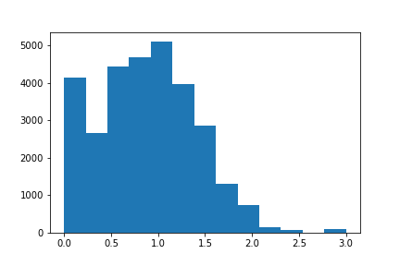
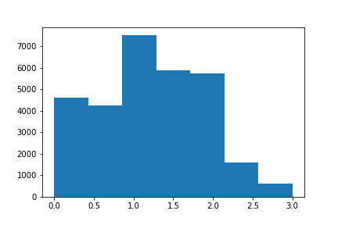
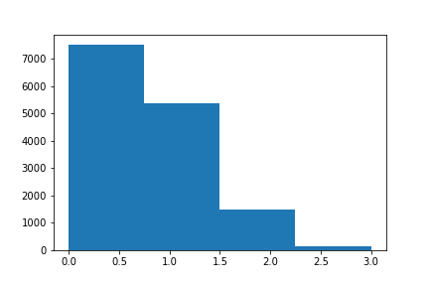
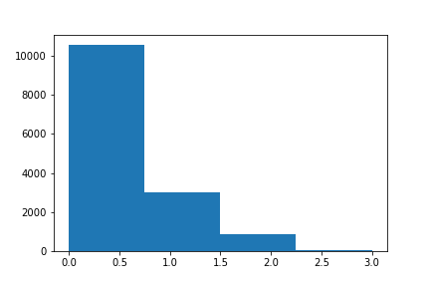
The effect of alcohol on mental health
Combined summary score
Alcohol from 16 yrs
Alcohol summary scale created from:
Beer consumption - ple0090
wine, champagne - ple0091
spirits consumpt - ple0092
mixed drinks - ple0093
Original scale: 1 regularly, 2 once in a while, 3 seldom, 4 never
Recode to 3 regularly, 2 once in a while, 1 regularly, 0 never
Data available for 2006, 2008, 2010
Combined data B5, alcohol: 2005/2006, 2009/2010
Spirits
Mixed drinks
Notes:
Additional to last time: Not just look at total composite score, but also at spirits and mixed drinks consumption

Slide 15
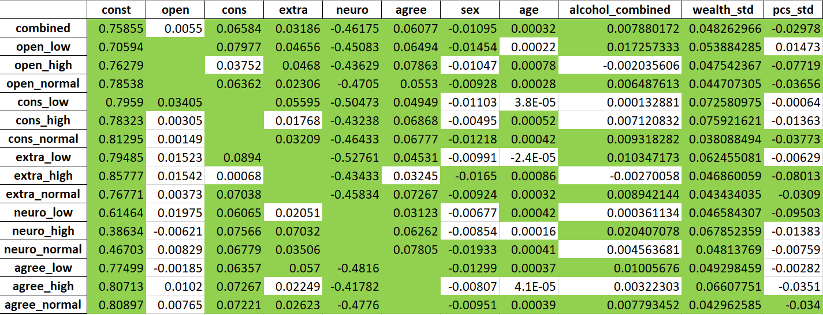
The effect of alcohol on mental health (all 4 comb.)
Notes:
Shows diverging effects for openness and extraversion

Slide 16
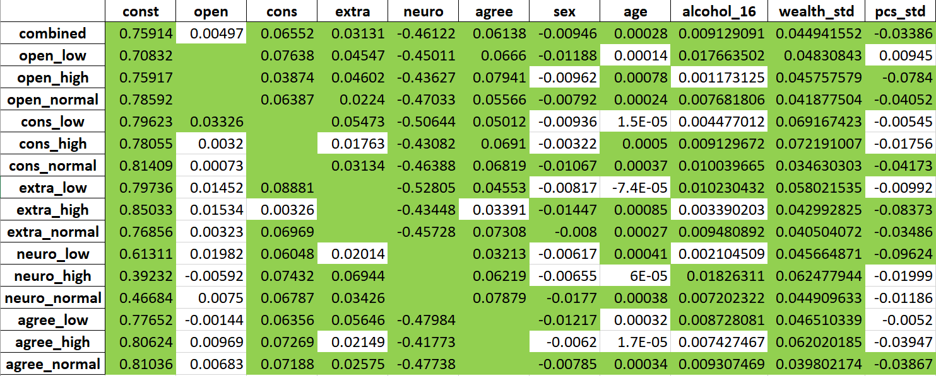
The effect of alcohol on mental health (alc_16)
Notes:
Here we have consistently positive effect

Slide 17
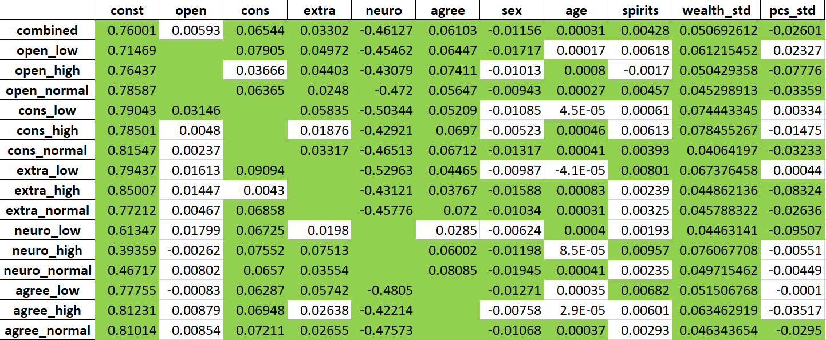
The effect of alcohol on mental health (spirits)
Notes:
Diverging effect for openness

Slide 18
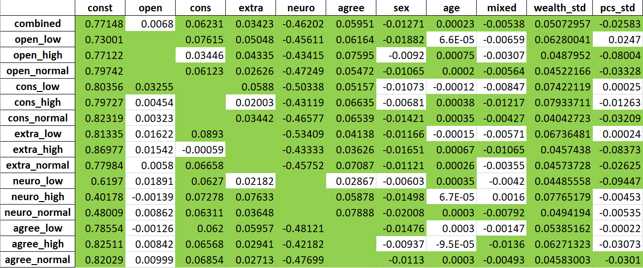
The effect of alcohol on mental health (mixed)
Notes:
Here, the effect is actually turned around -> dtrinking mixed drinks has overall a slightly negative effect

Slide 19
The effect of alcohol on mental health (combined)
 | age | agree | alcohol_combined | cons | const | extra | neuro | open | sex | wealth_std
combined | 0.00045 | 0.0605 | 0.007094 | 0.065419 | 0.737131 | 0.03422 | -0.45525 | -0.00303 | -0.01098 | 0.046005
open_low | 0.00023 | 0.052784 | 0.008398 | 0.062009 | 0.74551 | 0.032752 | -0.44223 |  | -0.01255 | 0.052898
open_high | 0.001335 | 0.051215 | -0.00722 | 0.029415 | 0.752885 | 0.0412 | -0.4866 |  | -0.00481 | 0.033391
open_normal | 0.000687 | 0.071413 | 0.008799 | 0.070061 | 0.714953 | 0.030549 | -0.46125 |  | -0.00833 | 0.039144
cons_low | 0.000104 | 0.06624 | 0.002945 |  | 0.803741 | 0.066852 | -0.48143 | -0.03114 | -0.01274 | 0.063223
cons_high | 0.000632 | 0.063913 | 0.005847 |  | 0.788134 | 0.012736 | -0.44418 | 0.004966 | -0.00799 | 0.055254
cons_normal | 0.00059 | 0.067256 | 0.00828 |  | 0.781633 | 0.033294 | -0.45686 | -0.00088 | -0.01235 | 0.034394
extra_low | 0.000108 | 0.056937 | 0.008881 | 0.082767 | 0.789716 |  | -0.51951 | -0.0044 | -0.01336 | 0.059751
extra_high | 0.001105 | 0.035885 | -0.00056 | 0.019445 | 0.768013 |  | -0.41305 | 0.014487 | -0.01156 | 0.029144
extra_normal | 0.000457 | 0.072567 | 0.008205 | 0.069649 | 0.749722 |  | -0.4531 | -0.00758 | -0.00918 | 0.040845
neuro_low | 0.000857 | 0.047882 | -0.00084 | 0.057202 | 0.514133 | 0.022545 |  | 0.025557 | -0.00274 | 0.03205
neuro_high | 0.000188 | 0.075441 | 0.016144 | 0.067796 | 0.388265 | 0.067016 |  | 0.000857 | -0.01321 | 0.064219
neuro_normal | 0.000441 | 0.07862 | 0.004548 | 0.068317 | 0.463439 | 0.038083 |  | -0.00036 | -0.01918 | 0.048067
agree_low | 0.000499 |  | 0.00927 | 0.073045 | 0.792761 | 0.054825 | -0.48814 | -0.03444 | -0.0119 | 0.043093
agree_high | 0.000392 |  | 0.003637 | 0.069088 | 0.757402 | 0.023155 | -0.41505 | 0.029178 | -0.00869 | 0.050128
agree_normal | 0.000532 |  | 0.006761 | 0.071205 | 0.777433 | 0.028932 | -0.46833 | 0.006765 | -0.00969 | 0.04015
Notes:
In combined model: all significant but openness
In separate models: alcohol differences non-significant

Slide 20
The effect of alcohol on mental health (alc_16)
 | age | agree | alcohol_16 | cons | const | extra | neuro | open | sex | wealth_std
combined | 0.000428 | 0.060987 | 0.008281 | 0.064966 | 0.734338 | 0.033535 | -0.45397 | -0.00309 | -0.00959 | 0.042499
open_low | 0.000204 | 0.053659 | 0.009977 | 0.061074 | 0.741823 | 0.031961 | -0.44041 |  | -0.01087 | 0.048698
open_high | 0.001356 | 0.051412 | -0.00479 | 0.030608 | 0.751205 | 0.040498 | -0.48788 |  | -0.00464 | 0.034271
open_normal | 0.000656 | 0.071609 | 0.008756 | 0.069666 | 0.714098 | 0.02991 | -0.46053 |  | -0.00722 | 0.035718
cons_low | 9.39E-05 | 0.066314 | 0.006248 |  | 0.80084 | 0.065864 | -0.48084 | -0.03265 | -0.01127 | 0.05937
cons_high | 0.000623 | 0.064627 | 0.007814 |  | 0.783031 | 0.012093 | -0.44246 | 0.005479 | -0.0065 | 0.051416
cons_normal | 0.000562 | 0.06754 | 0.008965 |  | 0.779389 | 0.032399 | -0.45573 | -0.00113 | -0.01098 | 0.030837
extra_low | 8.41E-05 | 0.057021 | 0.009605 | 0.082038 | 0.787719 |  | -0.51894 | -0.00465 | -0.01139 | 0.05552
extra_high | 0.001104 | 0.037329 | 0.003619 | 0.020625 | 0.761063 |  | -0.41222 | 0.013775 | -0.0101 | 0.026099
extra_normal | 0.000432 | 0.072861 | 0.00863 | 0.06881 | 0.747182 |  | -0.45131 | -0.0075 | -0.00807 | 0.03776
neuro_low | 0.000858 | 0.048198 | 0.000186 | 0.057313 | 0.512987 | 0.022301 |  | 0.025475 | -0.0025 | 0.031728
neuro_high | 0.000135 | 0.075206 | 0.014536 | 0.066943 | 0.388581 | 0.066113 |  | 0.001807 | -0.01167 | 0.059273
neuro_normal | 0.000428 | 0.079198 | 0.006999 | 0.068144 | 0.460428 | 0.037118 |  | -0.00078 | -0.0176 | 0.044429
agree_low | 0.00046 |  | 0.007853 | 0.072455 | 0.792695 | 0.05479 | -0.48639 | -0.03411 | -0.01121 | 0.040783
agree_high | 0.000386 |  | 0.006275 | 0.069016 | 0.754151 | 0.02246 | -0.41407 | 0.028464 | -0.00726 | 0.046975
agree_normal | 0.000509 |  | 0.008243 | 0.070718 | 0.774612 | 0.028226 | -0.46718 | 0.006876 | -0.00818 | 0.036769

Slide 21
Alcohol – Number of datapoints
b5_ds | low | high | normal | total
open | 10840 | 8630 | 48248 | 67718
cons | 9159 | 9436 | 49123 | 67718
extra | 10358 | 7830 | 49530 | 67718
neuro | 9536 | 11499 | 46683 | 67718
agree | 10334 | 8679 | 48705 | 67718
OLS_ds | low | high | normal
open | 7984 | 851 | 5910 | 14745
cons | 2153 | 2572 | 10020 | 14745
extra | 2856 | 1748 | 10141 | 14745
neuro | 1906 | 3308 | 9531 | 14745
agree | 2669 | 2188 | 9888 | 14745
b5_05_09 | low | high | normal
open | 9941 | 1441 | 9396 | 20778
cons | 3112 | 3633 | 14033 | 20778
extra | 4062 | 2487 | 14229 | 20778
neuro | 2785 | 4573 | 13420 | 20778
agree | 3864 | 3036 | 13878 | 20778
2005 | high | low | normal | total
open | 0 | 9565 | 886 | 10451
cons | 1952 | 1476 | 7023 | 10451
extra | 1301 | 1977 | 7173 | 10451
neuro | 2480 | 1297 | 6674 | 10451
agree | 1709 | 1821 | 6921 | 10451
2009 | high | low | normal
open | 1441 | 376 | 8510 | 10327
cons | 1681 | 1636 | 7010 | 10327
extra | 1186 | 2085 | 7056 | 10327
neuro | 2093 | 1488 | 6746 | 10327
agree | 1327 | 2043 | 6957 | 10327
2013 | high | low | normal
open | 1618 | 230 | 13696 | 15544
cons | 1505 | 1374 | 12665 | 15544
extra | 1197 | 1649 | 12698 | 15544
neuro | 1782 | 1487 | 12275 | 15544
agree | 1245 | 1624 | 12675 | 15544
2017 | high | low | normal
open | 3238 | 316 | 12751 | 16305
cons | 2446 | 2505 | 11354 | 16305
extra | 2240 | 2420 | 11645 | 16305
neuro | 2979 | 2412 | 10914 | 16305
agree | 2579 | 2483 | 11243 | 16305
2019 | high | low | normal
open | 2333 | 353 | 12405 | 15091
cons | 1852 | 2168 | 11071 | 15091
extra | 1906 | 2227 | 10958 | 15091
neuro | 2165 | 2852 | 10074 | 15091
agree | 1819 | 2363 | 10909 | 15091

Slide 22
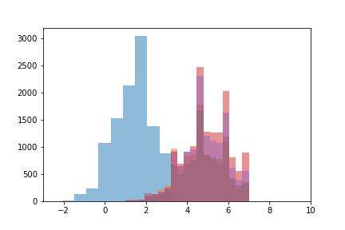
People were much less open in 2005?
mean | agree | cons | extra | neuro | open
2005 | 5.458281 | 5.899987 | 4.818757 | 1.285668 | 1.326883
2009 | 5.348536 | 5.823276 | 4.772002 | 1.156968 | 4.635871
2013 | 5.407726 | 5.839541 | 4.870642 | 1.084627 | 4.826287
2017 | 5.488674 | 5.795948 | 4.955234 | 1.110181 | 4.975146
2019 | 5.405356 | 5.778796 | 4.923154 | 0.905323 | 4.843039
Openness is summative score of plh0215, plh0220, plh0225, plh0255
plh0255 (inquisitive/wissbegierig) is missing for 2005, also not part of the original BFS-I

Slide 23
The effect of alcohol on mental health (combined)
 | age | agree | alcohol_combined | cons | const | extra | neuro | open | sex | wealth_std
combined | 0.000457 | 0.060409 | 0.007069 | 0.064598 | 0.734071 | 0.03242 | -0.45539 | 0.004858 | -0.01109 | 0.045336
open_low | 0.000149 | 0.065328 | 0.017685 | 0.080582 | 0.717659 | 0.04653 | -0.45371 |  | -0.01448 | 0.055573
open_high | 0.00112 | 0.079248 | -0.00356 | 0.03702 | 0.695731 | 0.04559 | -0.41945 |  | -0.01045 | 0.041341
open_normal | 0.000446 | 0.054877 | 0.005469 | 0.061995 | 0.754755 | 0.024058 | -0.46253 |  | -0.00952 | 0.041141
cons_low | 4.11E-05 | 0.049478 | 0.000119 |  | 0.795361 | 0.055954 | -0.50458 | 0.034014 | -0.01103 | 0.072527
cons_high | 0.000579 | 0.068394 | 0.00673 |  | 0.771687 | 0.017768 | -0.42913 | 0.002792 | -0.00501 | 0.074564
cons_normal | 0.00059 | 0.067209 | 0.008258 |  | 0.780761 | 0.032924 | -0.45673 | 0.000818 | -0.01237 | 0.03432
extra_low | 4.93E-06 | 0.04513 | 0.010191 | 0.089164 | 0.7898 |  | -0.52632 | 0.015057 | -0.00992 | 0.061805
extra_high | 0.001184 | 0.032775 | -0.00435 | -0.0014 | 0.794566 |  | -0.41723 | 0.010484 | -0.01683 | 0.039966
extra_normal | 0.000458 | 0.07231 | 0.008045 | 0.069021 | 0.742428 |  | -0.45176 | 0.003528 | -0.00941 | 0.040386
neuro_low | 0.000783 | 0.029457 | -0.00155 | 0.055567 | 0.551579 | 0.020063 |  | 0.015487 | -0.00579 | 0.039313
neuro_high | 0.000223 | 0.062587 | 0.019978 | 0.075027 | 0.376901 | 0.070431 |  | -0.00634 | -0.00865 | 0.066571
neuro_normal | 0.000446 | 0.077901 | 0.004356 | 0.067479 | 0.461738 | 0.035211 |  | 0.00813 | -0.01936 | 0.047324
agree_low | 0.000386 |  | 0.01001 | 0.063483 | 0.772686 | 0.056997 | -0.48105 | -0.00194 | -0.013 | 0.048983
agree_high | 0.000199 |  | 0.001967 | 0.070263 | 0.779041 | 0.023172 | -0.41008 | 0.008943 | -0.00822 | 0.063241
agree_normal | 0.000541 |  | 0.006828 | 0.070689 | 0.780498 | 0.02704 | -0.47014 | 0.007156 | -0.0097 | 0.039649
Notes:
In combined model: all significant but openness
In separate models: alcohol differences non-significant

Slide 24
The effect of alcohol on mental health (alc_16)
 | age | agree | alcohol_16 | cons | const | extra | neuro | open | sex | wealth_std
combined | 0.000434 | 0.06094 | 0.008262 | 0.064192 | 0.731375 | 0.031945 | -0.4541 | 0.004273 | -0.0097 | 0.041885
open_low | 9.74E-05 | 0.066863 | 0.017887 | 0.076854 | 0.715878 | 0.045443 | -0.45194 |  | -0.01182 | 0.049337
open_high | 0.00113 | 0.079992 | -0.00045 | 0.038341 | 0.691517 | 0.044737 | -0.41935 |  | -0.00976 | 0.040052
open_normal | 0.000426 | 0.055168 | 0.00658 | 0.06212 | 0.752167 | 0.023524 | -0.46166 |  | -0.0083 | 0.038286
cons_low | 3.98E-05 | 0.050044 | 0.004342 |  | 0.791672 | 0.054796 | -0.50514 | 0.032991 | -0.0094 | 0.068741
cons_high | 0.000575 | 0.068754 | 0.008689 |  | 0.765773 | 0.017731 | -0.42668 | 0.002866 | -0.00334 | 0.070564
cons_normal | 0.000562 | 0.067557 | 0.008959 |  | 0.778572 | 0.032279 | -0.45559 | 3.79E-05 | -0.01099 | 0.03081
extra_low | -2.8E-05 | 0.045241 | 0.009994 | 0.088458 | 0.789419 |  | -0.52606 | 0.014259 | -0.00822 | 0.057084
extra_high | 0.001199 | 0.034092 | 0.001583 | 0.001011 | 0.784794 |  | -0.41675 | 0.010238 | -0.01503 | 0.036307
extra_normal | 0.000433 | 0.072657 | 0.008551 | 0.068267 | 0.74009 |  | -0.45 | 0.003029 | -0.00827 | 0.037346
neuro_low | 0.000785 | 0.030263 | 0.000715 | 0.055625 | 0.548804 | 0.019556 |  | 0.015553 | -0.0052 | 0.03847
neuro_high | 0.000157 | 0.062144 | 0.017666 | 0.073465 | 0.37868 | 0.069641 |  | -0.00611 | -0.0068 | 0.060825
neuro_normal | 0.000432 | 0.078559 | 0.006887 | 0.067412 | 0.458582 | 0.034495 |  | 0.007269 | -0.01777 | 0.043748
agree_low | 0.000346 |  | 0.00864 | 0.0634 | 0.772294 | 0.056463 | -0.47886 | -0.00161 | -0.0122 | 0.045963
agree_high | 0.000198 |  | 0.00634 | 0.070145 | 0.774409 | 0.022228 | -0.40904 | 0.008332 | -0.00641 | 0.059079
agree_normal | 0.000517 |  | 0.00824 | 0.070248 | 0.778088 | 0.026667 | -0.46902 | 0.006323 | -0.0082 | 0.036367

Slide 25
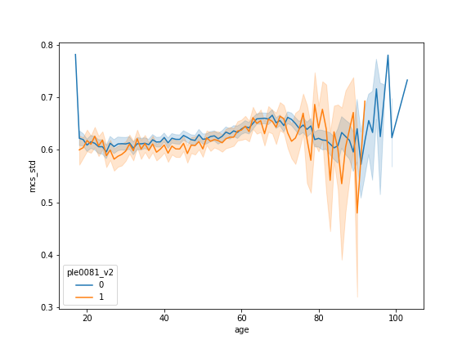
The effect of smoking on mental health
Do you currently smoke? -> ple0081_v2
Data in the model for 2006, 2010, 2014, 2018, 2020
Answers (after recoding 2->0, 1->1): 1 (25122), 0 (69652)
Notes:
0 is nonsmoking, 1 is smoking

Slide 26
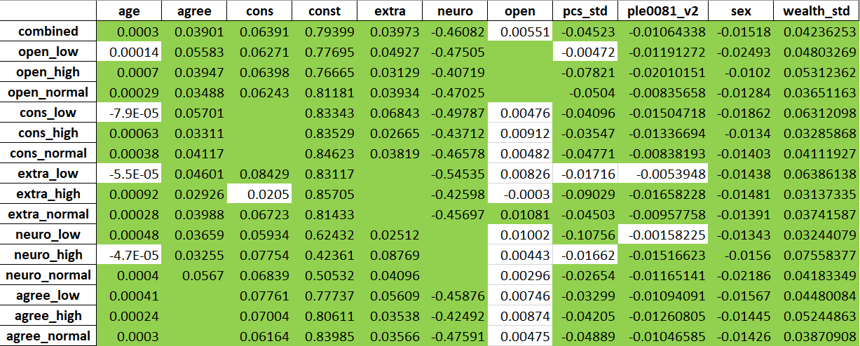
The effect of smoking on mental health
Notes:
Consistent negative effect

Slide 27
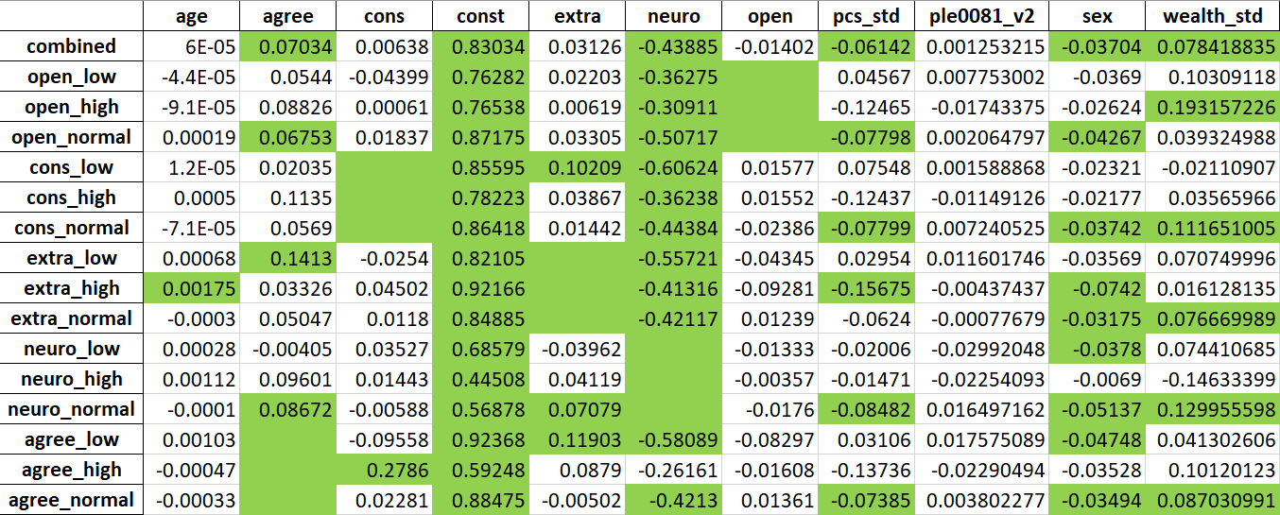
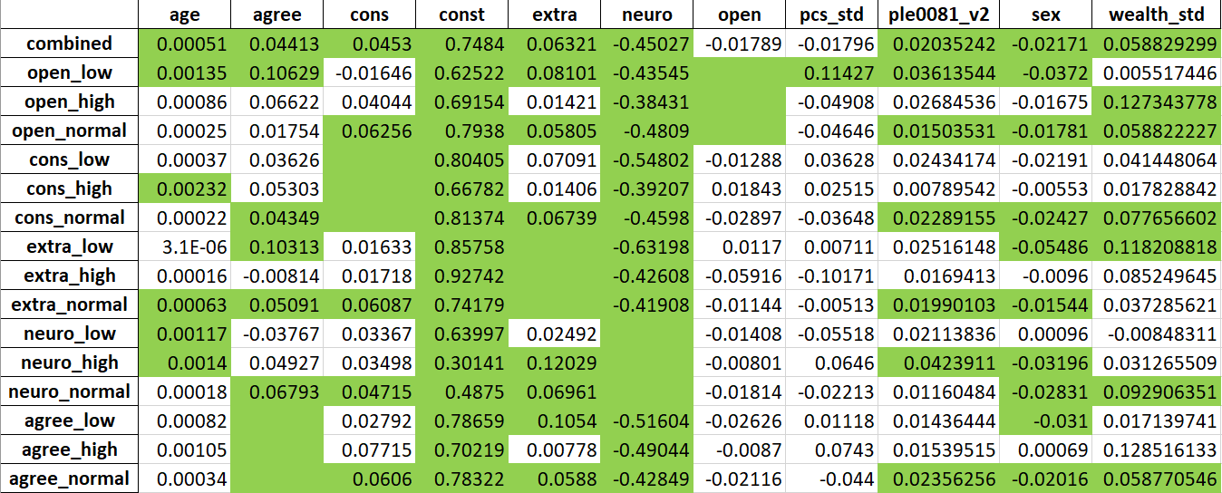
Changes of Smoking Behaviour
Started smoking 0 -> 1 (same encoding)
Stopped Smoking
1 -> 0 (same encoding)
Notes:
Here, we are just looking at the years of change (last time before the change and first time after the change)
Caveat: The number of cases here is very low -> Only 1179 participants started to smoke, 2138 stopped smoking
Keep in mind: 0 is not smoking, 1 is smoking
Therefore, the positive effect of stopped smoking is actually a negative effect for “stopping to smoke”
Starting to smoke is not significant, Stopping to smoke slightly reduces your mental health!

Slide 28
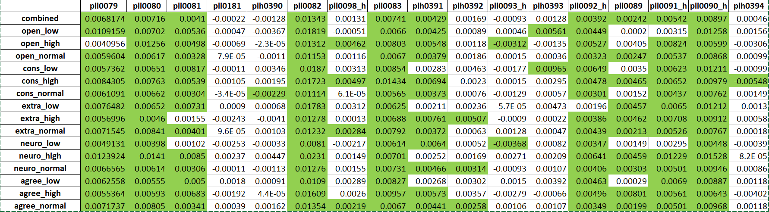
"pli0079": "Going out for dinner or drinks (café, pub, restaurant)", ****
"pli0080": "Visiting or being visited by neighbors, friends, or acquaintances", ****
"pli0081": "Visiting or being visited by family members or relatives", ****
"pli0181": "Keeping in touch with friends or relatives abroad (by telephone, e-mail, Internet phone, skype, etc.)", ***
"plh0390": "[de] Nutzen sozialer Online-Netzwerke / Chat-Dienste (z.B. Facebook / Instagram / Twitter / WhatsApp)“, *
"pli0082": "Going on an excursion or short trip", ****
"pli0098_h":"Going to church, attending religious events", ****
"pli0083": "[de] Fernsehen / Filme, Serien oder Videos sehen (auch Mediatheken / Internet-Streams / DVD / etc.)", ****
"plh0391": "[de] Lesen von Büchern (auch eBooks)", *
"plh0392": "[de] Lesen von (Tages-)Zeitungen (auch ePaper)", *
"pli0093_h": "Artistic and musical activities (painting, music, photography, theater, dance)", ****
"plh0393": "[de] Reparaturen am Haus, in der Wohnung oder an Fahrzeugen / Gartenarbeit / Fahrzeugpflege", *
"pli0092_h":"Taking part in sports", ****
"pli0089": "Going to sporting events", ****
"pli0091_h": "Going to the cinema, pop concerts, dance events, clubs", ****
"pli0090_h":"Going to cultural events such as opera, classical concerts, theater, exhibitions", ****
"plh0394": "[de] Einfach nichts tun / abhängen / träumen“ *
Notes:
Number of Stars: Number of years included in the analysis:
[2003, 2008, 2013, 2019]
4 Stars: Around 33,000 datapoints
3 Stars: Around 25,000 datapoints
1 Star: around 8,000 datapoints
-> For high/low on b5 personality score: This covers only 20% of the data
Interesting:
All consistently significant activities are positively associated -> This makes sense, as activities are usually voluntary, if they were associated with negative mental health outcomes, we might just stop them
Keeping in touch with friends or relatives abroad is mostly associated negatively -> This is not always voluntary, e.g. if you have many friends abroad you might be lonely / separated from your family
Usage of social Online networks also mostly associated negatively -> We know that too much Social Media consumption has negative effects on mental health (see addiction, compare to cigarettes and alcohol)
Both show positive effects in some subpopulations aswell
Going to church shows different effects for openness, extraversion, neuroticism and agreeableness -> Church can either be a place where people go to feel better, but also a place where some people do not necessarily go voluntarily
Musical activities shows differing activities, but very weak
Just doing nothing shows differing effect directions -> This makes some sense since this can be voluntary or not

Slide 29
Summary
There are significant relationships between some behaviour and mental health!
No different effect directions have been found for significant effects in behaviourally „extreme“ subpopulations!
There are some behavioural variables, where larger datasets could show effects going in different directions (e.g. for „online activities“, „going to church“ or „just doing nothing“) -> There could be some theoretical basis for that
Notes:
Testing many individual hypothesis: From knowledge theory and statistics perspective, results should not necessarily be taken as conclusive evidence

Slide 30
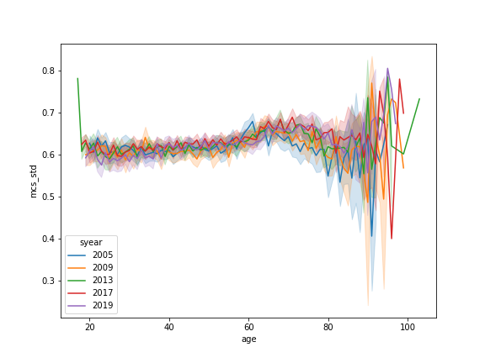
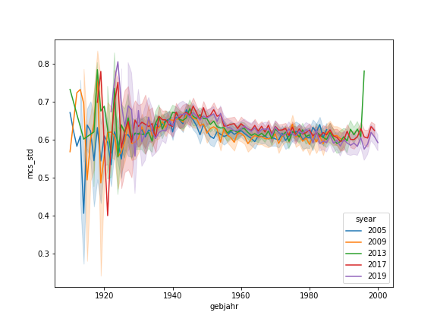
Little excursion: Age or Birth Year
The MCS curve shows a destinctive pattern for age
-> Is this an age or a birth year effect?
Notes:
This requires control for age (which I have done): Open Question: Is Age or Birth year the better control?

Slide 31
Next steps
Solve openness problem (exclude 2005/use openness w/o plh0255)
Re-run OLS for alcohol
Use existing pipeline for other variables
Watching TV [2003,2008,2013,2019]
Smoking [2004, 2006, 2008, 2010, 2014, 2016, 2018, 2020]
Social Media Use [2019]

